Slide 1



MECON
Study on Impact of Quality Control Orders on Indian Steel Sector
June 2020
Deloitte Touche Tohmatsu India LLP

Slide 2
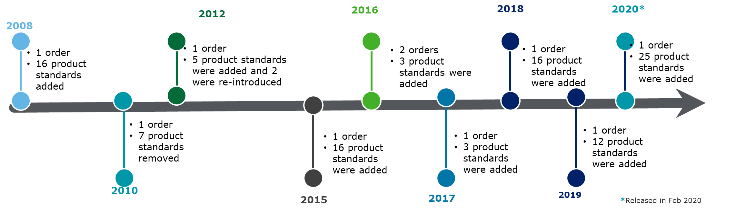
Introduction
Quality Control Orders in Steel were introduced by Ministry of Steel from 2008 onwards with the objective of bringing standardization and improve quality products in the Indian steel market
Timeline of Orders
Key Objectives of QCO
Product standardization
Quality assurance
Public safety
97
Products covered
66 Steel/ Stainless Steel Product Standards (till Dec 19)
1 standards on Transformer Lamination & Stamping
5 standards on Mild Steel Pipes and Tubes (DIPP)
Feb 2020 Order – 25 new product standards added
Objectives of the assignment
Genesis and coverage of the QCO
Effectiveness of QCO in ensuring quality
Impact of QCO on MSME sector and in Make India
Challenges faced by steel clusters
Extent of coverage of QCO in imported steel
Market sentiments vis-a-vis QCO

Slide 3
Steel & Steel Products Coverage (1/2)
More than 71 Product standards already brought under coverage within QCO across different steel product segments
Key Products
FY 19 Production (5 Yr. CAGR)
FY 19 Imports (5 Yr. CAGR)
Secondary Steel Producer Share
Product Standards covered in QCO#
1
Steel used for construction structures, Carbon steel cast billets, ingots for re-rolling into structural steel etc.
6
Steel Structural
10 MT (4.7%)
0.1 MT (14%)
2
Bars & Rods
(Non-Alloy)
21
Steel bars and wires for concrete reinforcements, forgings etc.
38 MT (4.8%)
0.35 MT (-20%)
3
4
Galvanized Steel
Galvanized Plain/ Corrugated sheets
9.5 MT (6.5%)
1.2 MT (29%)
4
9
Hot Rolled
Hot Rolled Coils , Sheets, Plates etc.
40 MT (8 %)
2 MT (-2%)
5
3
Cold Rolled
Cold Rolled Coils , Sheets, Plates etc.
15 MT (6.6 %)
0.6 MT (-24 %)
* Separately brought out by BIS for Ductile Iron Pressure Pipes (1), Fittings (1) and Mild Steel Tubes (3), under DIPP
MT = Million Tonnes
# Product standards introduced in Feb 2020 are not yet implemented hence kept out of the scope here

Slide 4
Steel & Steel Products Coverage (2/2)
More than 70 Product standards already brought under coverage within QCO across different steel product segments
Key Products
FY 19 Production (5 Yr. CAGR)
FY 19 Imports (5 Yr. CAGR)
Secondary Steel Producers Share
Product Standards covered in QCO#
6
5*
Pipes & Tubes
Tubes of Mild Steel, Ductile Iron Pressure Pipes
2.2 MT (2.2 %)
0.3 MT (26 %)
7
Steel Plates for Pressure Vessels, Chequered sheets etc.
4
Plates
6 MT (7.2 %)
0.6 MT (-10 %)
8
Cold rolled Non-oriented/ Grain-oriented electrical sheets (CRGO/ CRNO), Magnetic materials
4
Electrical Sheets
0.3 MT (18.9 %)
0.7 MT (14 %)
9
Alloy Steel
10
Al/ Zn alloy coated steel sheets, strips etc.
7 MT (7.4 %)
1.4 MT (-7 %)
10
Stainless Steel
5
Stainless Steel utensils
4 MT (7 %)
0.5 MT (0 %)
# Product standards introduced in Feb 2020 are not yet implemented hence kept out of the scope here
MT = Million Tonnes
# Alloy Steel covers – Alloy Steels (including Flat and Long) as well as Ferro Alloys (4)

Slide 5
Our Assessment on QCO Effectiveness
While coverage of product standards have increased, renewed focus on Enforcement and Governance may be required to drive adoption and compliance levels to achieve the intended objectives
Dimensions
Stakeholders
Impact Areas
Enforcement
BIS
Certification
Sample Testing
Surveillance
Reporting
Indigenous Product Compliance
Steel Producers
Registration
Testing
Process Configuration
Cost of Compliance
Imported Product Compliance
Steel Importers
Registration
Harmonization
Testing
Reporting
Governance
Ministry of Steel, BIS
Product Standards
Capability Building
Incentives
Monitoring & Evaluation
Adoption growing especially in B2B segments and Govt. procurement
Even Chinese importers are getting products certified by BIS
Increasing products are coming under coverage
Limited testing infrastructure, absence of testing at ports of import
Regular Technical reviews to ensure harmonization with international standards
Inadequate manpower for regular surveillance
High Compliance Cost and capital required for processes revamp to adhere to QCO norms
Markets price-sensitive rather than quality sensitive, low incentives for quality focused producers
Lack of dedicated portal for information dissemination

Slide 6
Key challenges and impact of QCO on Secondary / MSME sector
Increasing Costs of Compliances and High Capex requirements have prevented wider adoption of the QCO norms among MSME/ secondary steel producers
Impact Areas
Inputs
Processing
Testing
Input Costs typically higher due to lack of scale
Unreliable supply of quality raw material
High Investments required for setting up new lines, land etc.
Increased financing costs
Low control over chemical composition and quality due to use of Induction Furnaces
Lack of access to technical Know how for improving processes and quality control
Significant Process Change / System Overhaul Costs
Inadequate testing facilities / Lack of shared testing facilities
Very few Secondary Players have capacity to set up private testing infra
Higher lead times for sample testing
Notes:
NIFTY Metals-

Slide 7
Key Recommendation to improve QCO effectiveness
Dimensions
Recommendations
Enforcement
Test Centers
Surveillance Cells
Dedicated Portal for Reports
Cluster specific data maintenance
Increase number of test centers in each steel cluster
Shared testing facilities
Active sample collection should be undertaken
More number of audits should be conducted
More surprise visits to inspect non-registered factories
Dedicated portal to keep track of initiatives
Access to reliable data regarding overall enforcement statistics
Dashboard for monitoring compliance
Cluster specific databases to improve tracking of industries
Integration can also be done with GST database
Indigenous Product Compliance
₹
Non – financial incentives
Financial Incentives
Ecosystem Building
Supply Guarantee of Raw materials for MSMEs
Tolerance limits for MSMEs can be extended for a longer period
Loans at competitive rates for capital investment
Tax holidays and subsidies can be provided
Generic promotion activities for BIS standards
Export Promotion schemes can be beneficial
Technical support and guidance for revamp of process
5 A Framework
Long Term measures
Short & Medium term measures
Appropriateness
Adequacy
₹
Affordability
Accessibility
Availability

Slide 8
Key Recommendation to improve QCO effectiveness
Dimensions
Recommendations
Imported product compliance
Test Centers
Feedback/complaints
Harmonization
Improvement in testing infra at ports
Enhancement in record keeping through SIMS
Extensive feedback from importers
Portal for lodging of complaints and redressal
Alignment with global standards
Reduce dependency on external certification organization
₹
Governance
Awards for quality focused MSMEs
Fund R&D
Technical Reviews
Awards for quality focused MSMEs to speed up adoption
Acknowledgement of good practices in conformance
R&D for making quality compliant steel using induction furnaces
Integration of technologies to improve traceability
Streamlining of processes for changing tech specs on new standards to make it less time consuming
5 A Framework
Long Term measures
Short & Medium term measures
Appropriateness
Adequacy
₹
Affordability
Accessibility
Availability

Slide 9
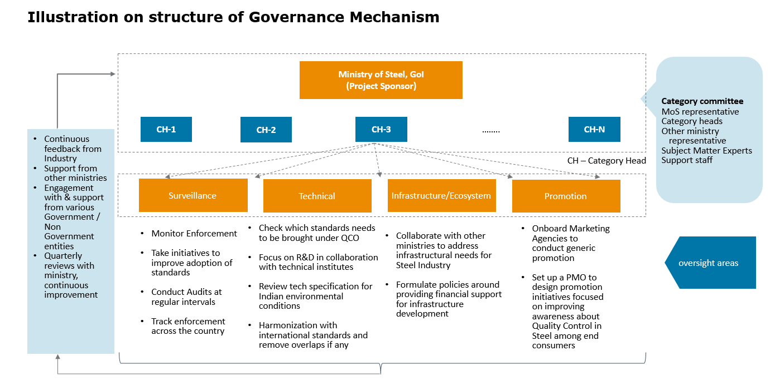
Governance Mechanism
Supported by a Dedicated Portal for Steel & Steel Products QCO for regular reporting and updates on enforcement

Slide 10
Thank You

Slide 11
Appendix

Slide 12

Enforcement
Focus Area
Key highlights
BIS Certification has led to standardization of products increasing their competitiveness
However there is lack of awareness specially amongst the B2C consumers where brand power plays a significant role
Certification
Lack of adequate testing infrastructure in steel clusters, producers have to wait for a long time to send their samples for testing to far away labs
Some large scale players have set up their own private testing infrastructure , not feasible for small scale producers
Testing
Limited manpower for conducting periodic inspections and dearth of comprehensive IT systems prove a major challenge for surveillance activities
Surveillance
Absence of a comprehensive database and a dedicated portal providing reliable data to ascertain the quantum of non-compliant products
Reporting
Notes:
NIFTY Metals-

Slide 13
Indigenous product compliance
Focus Area
Key highlights
Most Integrated Players have registered and certified their products under QCO norms
However, a large number of smaller producers lack incentives to go for certifying under QCO norms since they operate in the local markets which is not so quality sensitive
Registration
Huge capital investments are required for overhauling existing processes and modernization to meet new standards
Availability of easy financing is a major challenge for many small scale players
Process configuration
Testing costs add up to the product costs, rendering them less competitive in a price sensitive domestic market with no major export promotion activities for quality focused players
Testing
Cost of production
Since most small scale producers depend on Induction Furnace, availability of quality raw materials at competitive prices is key for improving quality of finished products
Challenges in terms of unreliable supply of quality raw materials, increasing surface transportation costs also add to the cost of production
Notes:
NIFTY Metals-

Slide 14
Imported product compliance
Focus Area
Key highlights
Even some of the Chinese exporters have focused on getting BIS certifications for their products highlighting the increasing adoption of these norms among global exporters
Registration
There is a preference amongst certain manufacturers for international standards due to the presence of additional parameters/specific requirements
The feasibility is less for manufacturers manufacturing small quantities of niche products
Harmonization
Inadequate testing infrastructure available at Indian ports leads to dependence of Inspection Certificates from importers , increasing chances of inferior quality products entering the domestic markets
Testing
Steel Import Monitoring Systems (SIMS) was launched recently (fully functional from Nov 2019), providing reporting for imports (including QCO adherence)
Reporting
Notes:
NIFTY Metals-

Slide 15
Governance
Focus Area
Key highlights
Product standards
Technical Review Committees regularly meet to review product standards and increase coverage under QCO norms and ensure overlapping technical specifications are removed
There is strong need for institutional and policy support (including project monitoring, development of labs, manpower/ skills) to increase the efficacy of the framework of the quality control orders
Capacity building
Lack of incentives like tax holidays/ EMI Moratoriums/ Subsidies has resulted in few SSPs investing on the required modernization/ processes for producing QCO compliant products
Govt. procurements mostly happens from large integrated players (as they can supply bulk requirements) thus impacting the demand from small scale manufacturers
Incentives
There is a need for a dedicated platform to increase the access to reliable information and to conduct regular assessment of the adoption/ compliance of QCO norms
Monitoring and evaluation
Notes:
NIFTY Metals-

Slide 16

Enforcement
Testing Labs
Testing infrastructure needs to be ramped up to increase surveillance and to ensure better adoption of quality standards.
1
Dedicated Portal
Dedicated portal for Steel QCO to report on compliance levels of steel producers and facilitate up to date information on all information related to QCO
2
3
Cluster level database and dedicated portal
Due to lack of collection and maintenance of databases at the cluster level, knowledge dissemination becomes a major challenge
4
Surveillance Cell
To cater to the shortage of officers at field level and to conduct random checks and regular sessions to spread awareness amongst industry players
Notes:
NIFTY Metals-

Slide 17
Indigenous Producers
Non financial Incentives
Supply Guarantee Programs to assure quality focused MSMEs access to reliable supply of quality raw material, setting up adequate shredding units and development of dry ports for import of scraps
Tolerance limits for MSMEs can be extended for a longer period so that they can have the time to gradually build their capacity and capabilities to comply to these norms
1
2
Financial Incentives
Tax Holidays or Subsidize 20-30% Investments for small units going for modernization (EAF/ LRL units)
Arranging loans at subsidized rates or entering into Tripartite Financing partnership
2
3
Ecosystem Development
Generic promotion amongst end consumers on importance of conformity to Quality standards will help in wider adoption and acceptance of QCO and lesser dependency on Brand
Export Promotion Cells in Steel Clusters helping in knowledge dissemination on importance of quality standards , key export markets , harmonization etc.
Technical support and guidance for MSMEs helping them revamp of process for improving quality production and process control
Notes:
NIFTY Metals-

Slide 18
Imported Products Compliance
Testing Labs at Ports
To reduce dependency on the inspection certificates provided by exporters, testing labs can be set up at all major ports where bulk quantitates of steel and steel products are imported
1
2
Harmonization
Low awareness amongst manufacturers and additional parameters covered under international standards lead to a preference for them
2
3
Feedback/complaints
Extensive feedback from importers
Portal for lodging of complaints and grievance redressal
Notes:
NIFTY Metals-

Slide 19
Governance
Review of technical specifications
Taking into account local context and domestic ore quality is of utmost importance during review of standards for different categories
1
2
Awards for quality focused MSMEs
More rewards and recognition for MSMEs in steel who have regularly complied to quality norms to encourage further adoption of these norms across all MSMEs
2
3
Commissioning Research
Fund R&D in top technical institutes focusing on making quality compliant steel even using Induction furnaces
Research on making quality compliant steel using induction furnaces majorly used by MSMEs can go a long way in quality improvement
Notes:
NIFTY Metals-

